Slide 2
The Approach to the High-Risk of Bleeding patient
Roxana Mehran
MD, FACC, FAHA, MSCAI, FESC
Professor of Medicine (Cardiology), and Population Health Science and Policy
Icahn School of Medicine at Mount Sinai New York, NY, USA

Slide 3
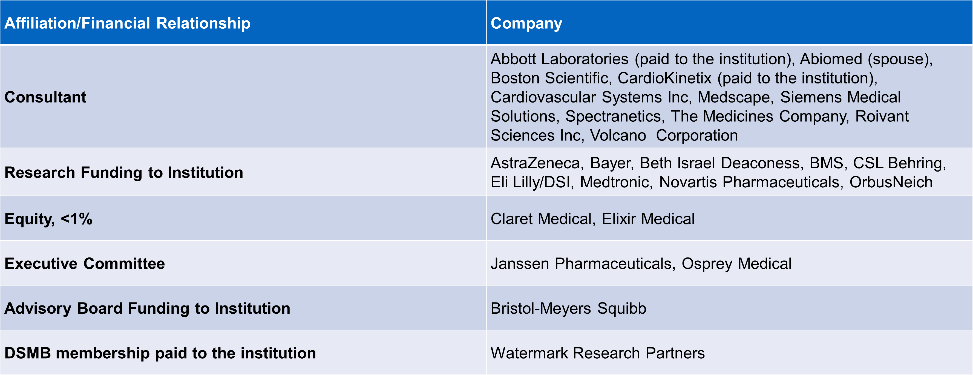
Disclosures

Slide 4
BACKGROUND
IMPACT OF BLEEDING AFTER CORONARY STENTING

Slide 5
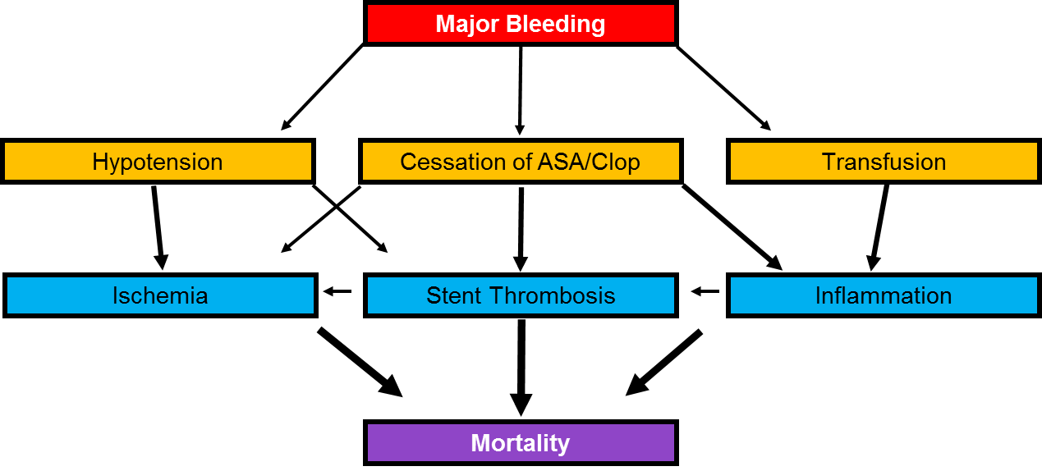
Bleeding and Mortality

Slide 6
ACUITY
Influence of Major Bleeding and MI in the First 30 Days on Risk of Death Over 1-Year
Of 13,819 enrolled patients, 524 (3.8%) died within 1 year
Cox model adjusted for 36 baseline predictors, with MI and major bleeding (non-CABG) as time-updated covariates
Mehran RM et al. EHJ 2009;30:1457-66
Note: Attributable deaths = N deaths among pts with
the time-updated event (attribute) X (adj. HR – 1)/adj. HR

Slide 7
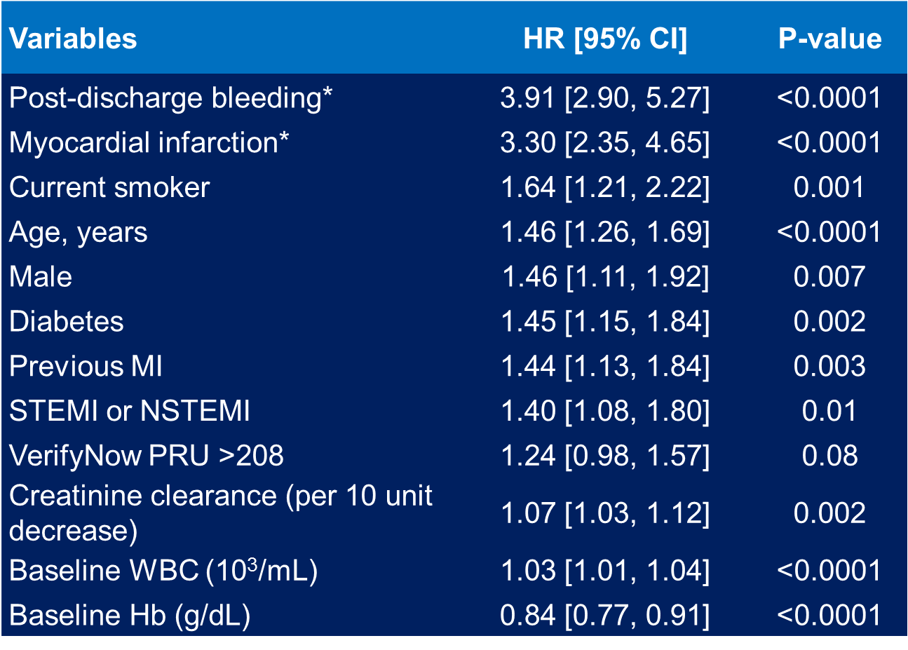
Data from ADAPT-DES study (2-years follow up)
Post discharge bleeding increases mortality significantly
Généreux P. et al. J Am Coll Cardiol. 2015 Sep 1;66(9):1036-45

Slide 8
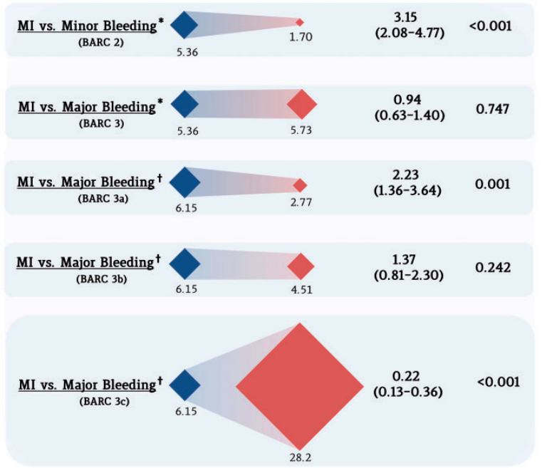
Differential impact of MI vs Bleeding on Mortality
A total of 12,944 patients with non-ST-segment elevation ACS from the Thrombin Receptor Antagonist for Clinical Event Reduction in Acute Coronary Syndrome (TRACER) trial
Risk of death after MI was significantly lower than after BARC 3c bleeding
(RR 0.22; 95% CI 0.13–0.36; P < 0.001).
Valgimigli M, et al. Eur Heart J. 2017 Mar 14;38(11):804-810

Slide 9
High Bleeding Risk Patients
Who are they?
Why are they important?
Why were they previously ignored?

Slide 10
What does High Bleeding Risk really mean?
Predictable bleeding risk
Prior bleeding
Upcoming surgery
Stacking therapy (e.g. anticoagulation)
Risk stratification/scoring
(age, anemia, other factors)
Unpredictable bleeding risk
Trauma
Subclinical pathology (unexpected need for surgery, undiagnosed malignancy, new AF)
Hyperresponsiveness to DAPT agents

Slide 11
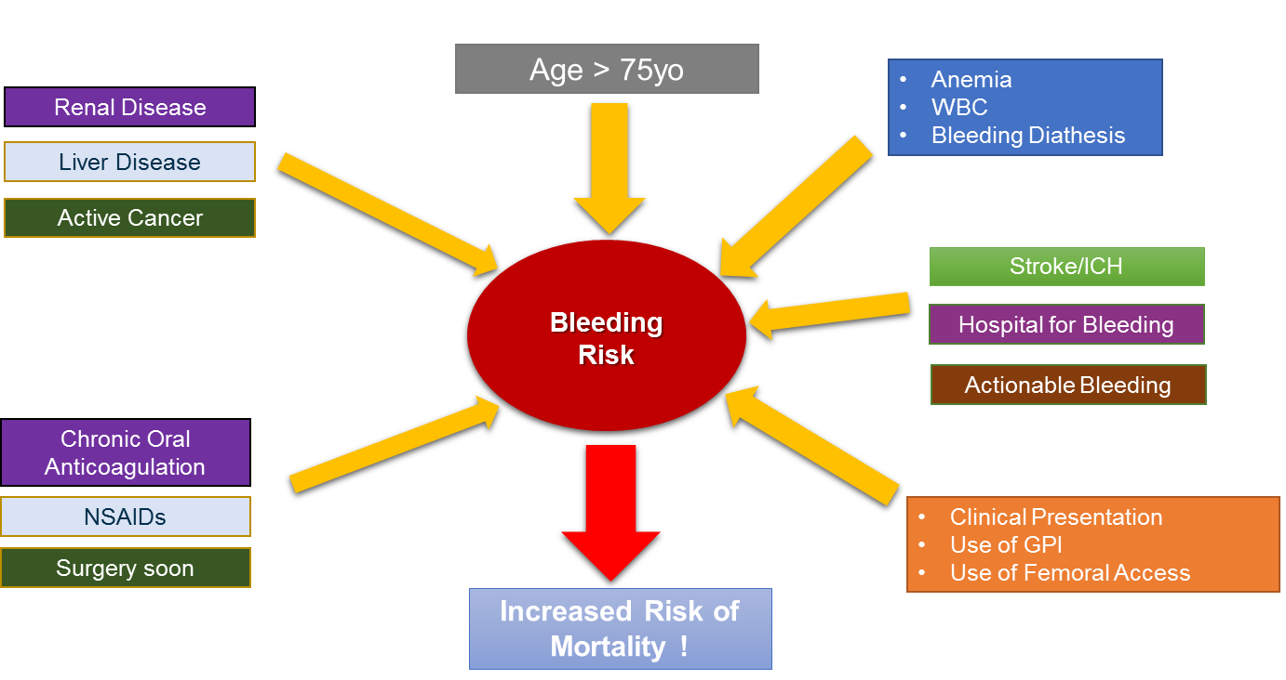
Reasons for High Bleeding Risk Patients after PCI
Female Gender?
PAD?
Abnormal BMI?
Smoking?

Slide 12
Overview
In a contemporary population of patients undergoing PCI, it is estimated that about one-third are at high bleeding risk!
Due to fears of late ST with 1st gen-DES requiring longer duration of DAPT and previous guideline recommendations, HBR patients were usually excluded from prior DES trials
As a consequence, the optimal strategy for these patients remained poorly defined regarding both choice of stent type and DAPT duration

Slide 13
Real World Distribution of Bleeding risk determinants
Mount Sinai Cath Lab
10,406 Patients underwent PCI and stent implantation
Sorrentino S, Mehran R. et al. Thrombosis and Haemostasis, in press

Slide 14
Why are HBR patients being considered for
shorter DAPT trials now?
Attributes of HBR Patients Favoring Shorter DAPT
Compelling clinical case
Guidelines recommend shorter duration (shorter overall study)
More bleeding events (easier to show superiority)
Possibly more thrombotic events (easier to show non-inferiority)?

Slide 15
CLINICAL DATA
RECENT TRIALS ON HBR PATIENTS

Slide 16
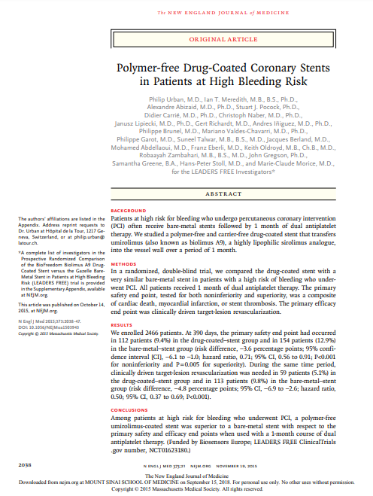
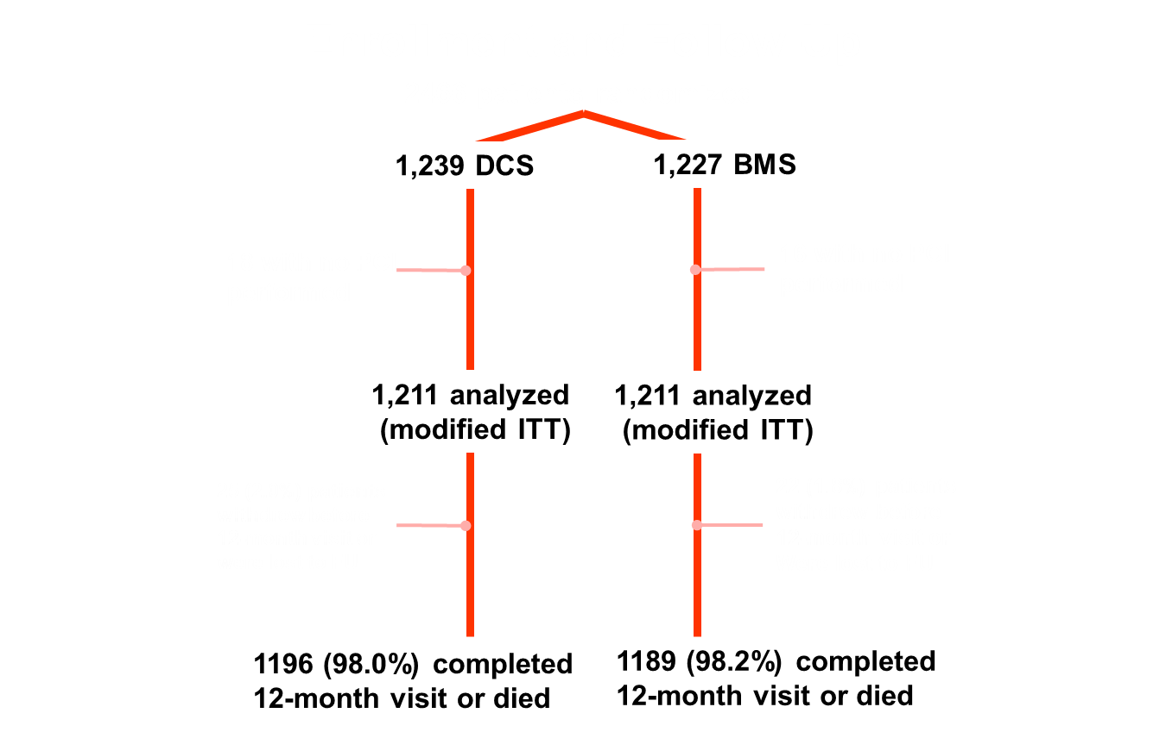
Urban P. Et al. N Engl J Med. 2015 Nov 19;373(21):2038-47

Slide 17
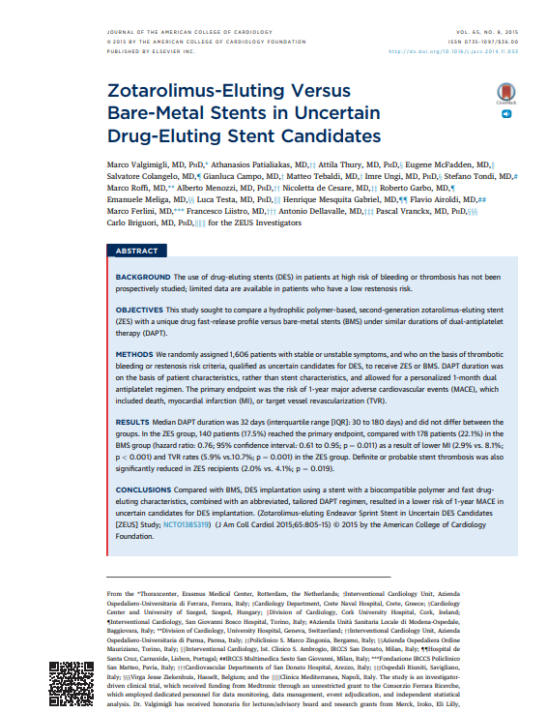
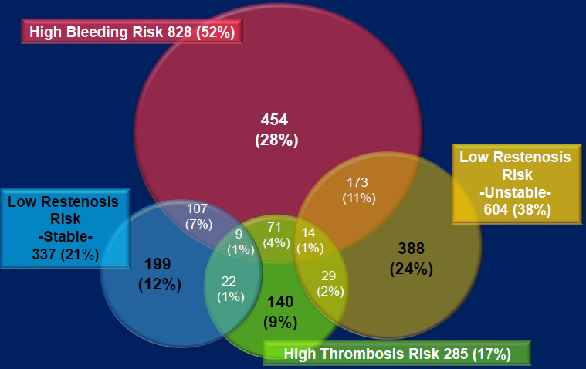
ZEUS
Patients at high bleeding risk
Patients at high thrombosis risk
Patients at low risk of in-stent restenosis
Valgimigli M, et al. J Am Coll Cardiol. 2015;65:805-815

Slide 18
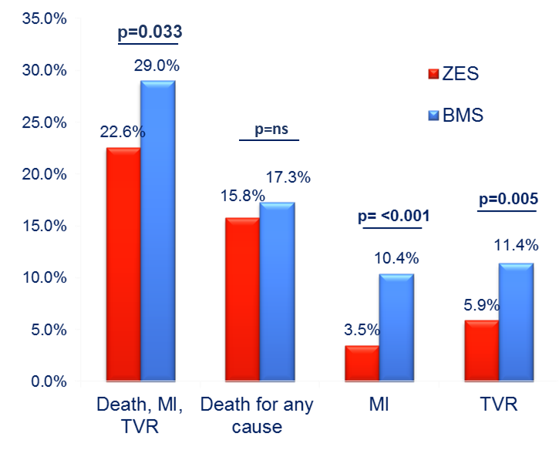
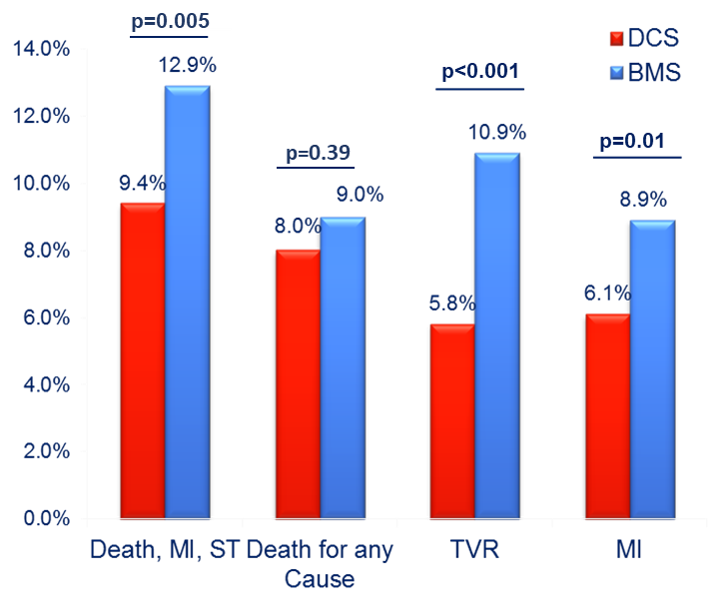
Outcomes in HBR patients: 1-year follow-up
ZEUS Trial
LEADERS FREE Trial
Ariotti S, et al. JACC Cardiovasc Interv. 2016 Mar 14;9(5):426-36
Urban P. Et al. N Engl J Med. 2015 Nov 19;373(21):2038-47

Slide 19
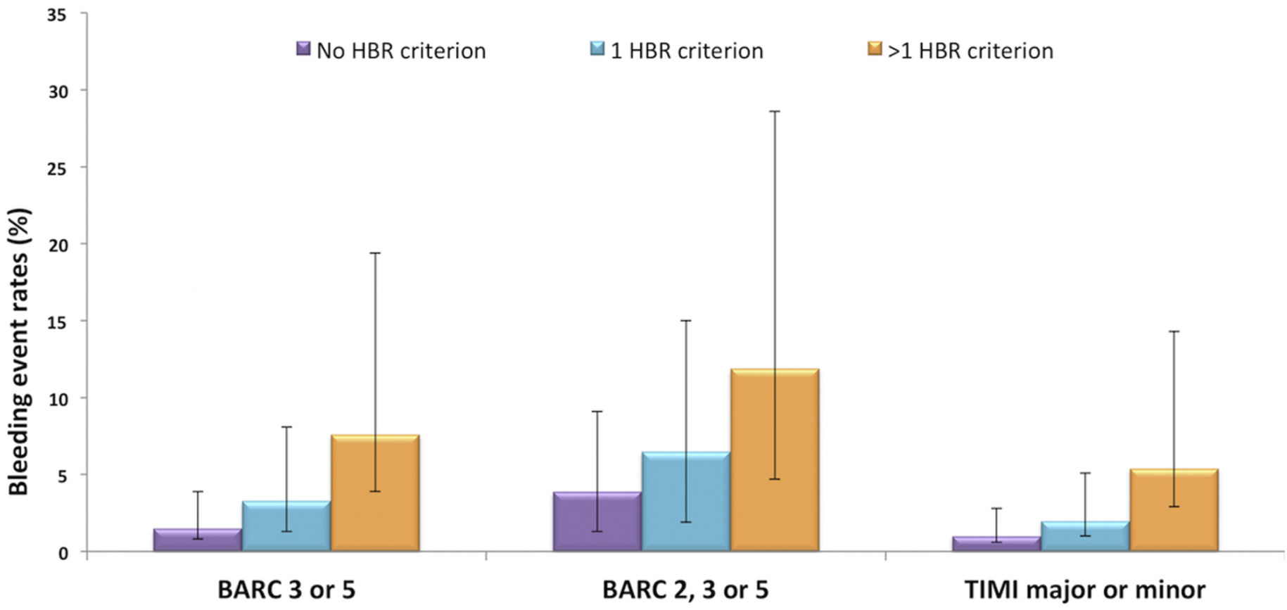
ZEUS Trial Outcomes by Inclusion Criteria Applied
Ariotti S, et al. JACC Cardiovasc Interv. 2016 Mar 14;9(5):426-36

Slide 20
SENIOR
Randomized (1:1), single blind trial
1,200 patients aged 75 years and above
Tailored DAPT: 1 mo in stable and 6 mo in ACS pts
Prespecified by the investigator prior to randomization
DES
BMS
vs
Primary End Point: all-cause mortality, non-fatal MI, stroke, ID-TLR at 1 year
Secondary End Points: Bleeding BARC 2-5/3-5, ST at 1 year

Slide 21
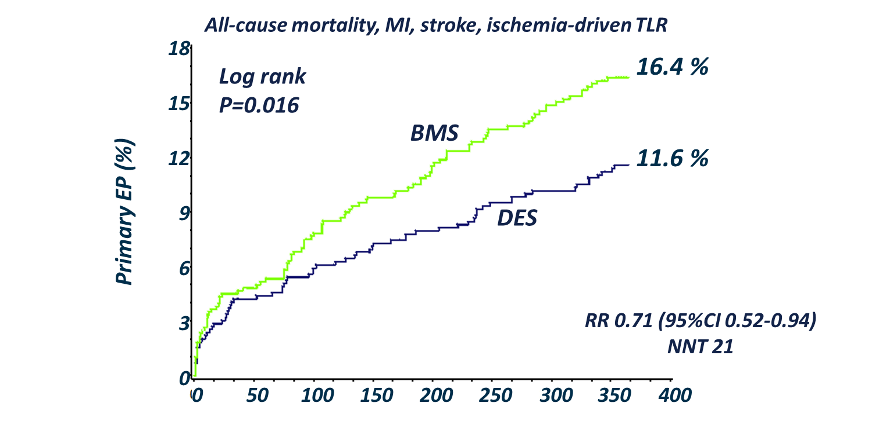
SENIOR: Primary Endpoint

Slide 22
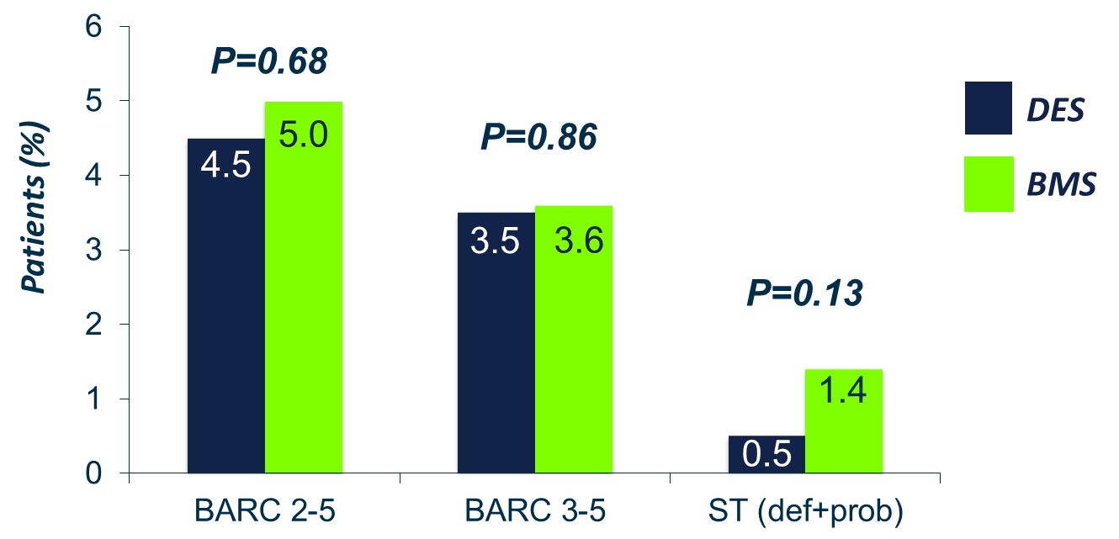
SENIOR: Safety Endpoints

Slide 23
ONGOING HBR TRIALS

Slide 24
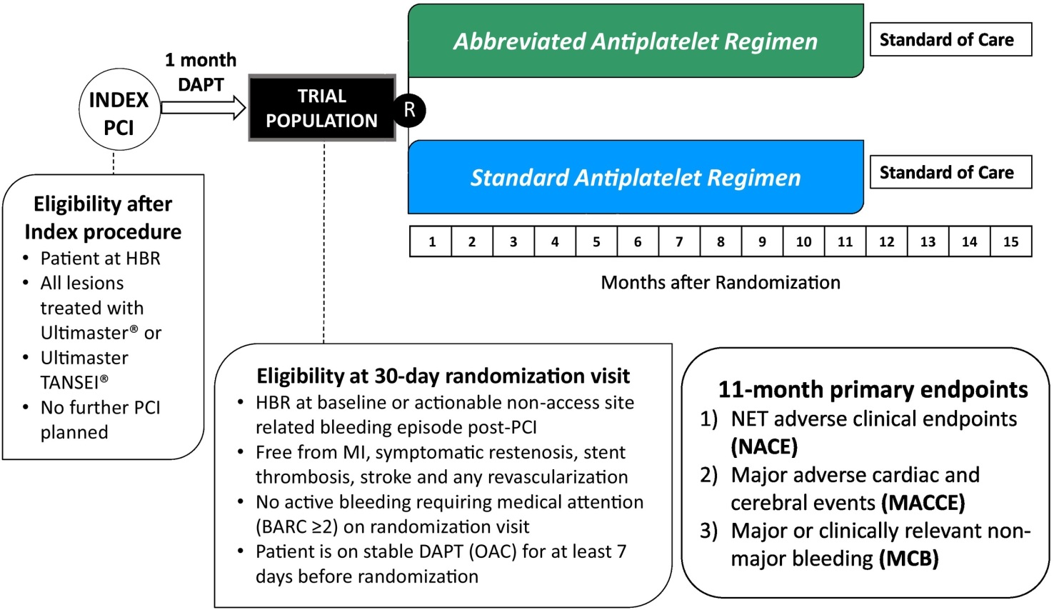
MASTER DAPT MAnagement of high bleeding risk patients post bioresorbable polymer coated STEnt implantation with an abbReviated versus prolonged DAPT regimen
Frigoli E. et al. American heart journal. 2019 Mar 1;209:97-105.

Slide 25
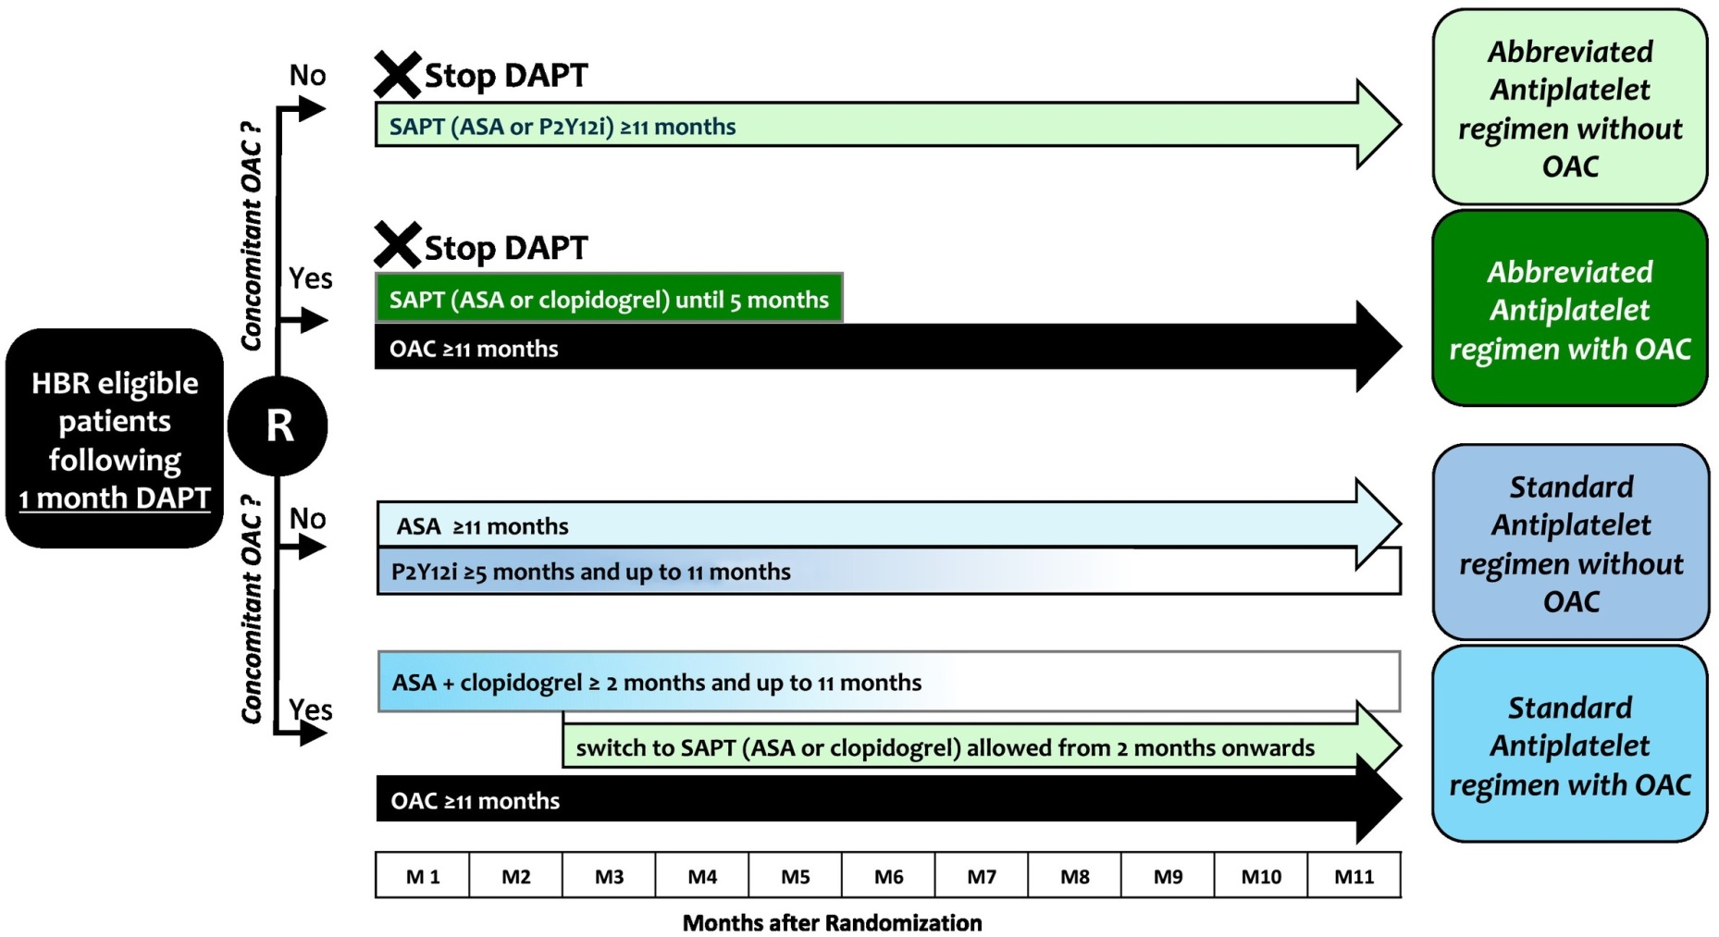
Treatment in the experimental and control arm
Frigoli E. et al. American heart journal. 2019 Mar 1;209:97-105.

Slide 26
Primary and Secondary Endpoints
Co-primary endpoints:
Net adverse clinical endpoints (NACE) defined as a composite of all-cause death, myocardial infarction, stroke and bleeding events defined as BARC 3 or
Major adverse cardiac and cerebral events (MACCE) defined as a composite of all-cause death, myocardial infarction and stroke
Major or clinically relevant non-major bleeding (MCB) defined as a composite of type 2, 3 and 5 BARC bleeding events
The main analyses evaluate the occurrence of the primary endpoints between randomization and 11 months thereafter. In secondary analyses, the occurrence of primary endpoints between randomization and 15 months after index PCI to be evaluated.

Slide 27
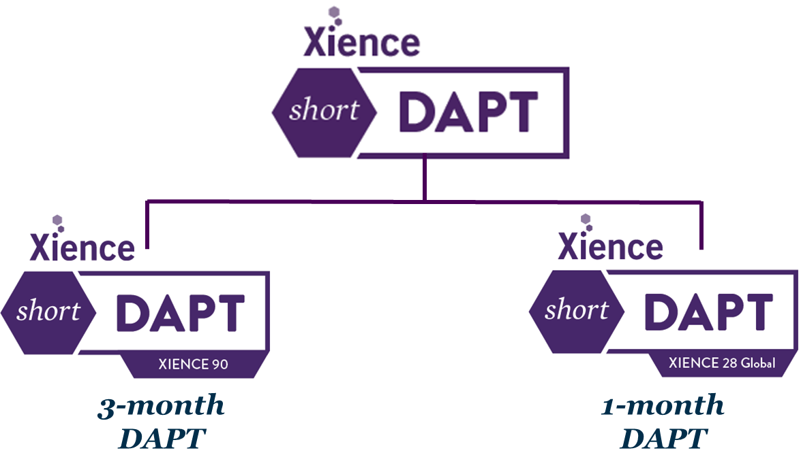
Xience Short DAPT Program
©2017 Abbott. All rights reserved. AP2944979-US Rev. A

Slide 28
©2017 Abbott. All rights reserved. AP2944979-US Rev. A

Slide 29
©2017 Abbott. All rights reserved. AP2944979-US Rev. A

Slide 30
Onyx ONE RCT Study (N = 2000)
Lead PI: Prof. Stephan Windecker
Co-PI: Dr. Azeem Latib & Dr. Elvin Kedhi
Program Chair: Dr. Gregg W. Stone
Sponsor: Medtronic

Slide 31
EVOLVE Short DAPT Prospective, N= ~2,000 patients, ~120 global sites

Slide 32
Varying Definitions of High Bleeding Risk in PCI trial
LEADERS FREE
Oral anticoagulation use
Age ≥ 75 years
Baseline Hb < 11 g/dl
Any prior intracerebral bleed
Any stroke in the last 12 months
Hospital admission for bleeding during the prior 12 months
Non skin cancer diagnosed or treated < 3 years
Planned daily NSAID (other than aspirin) or steroids for >30 days after PCI
Planned surgery that would require interruption of DAPT (within next 6 months)
Creatinine clearance <40 ml/min
Platelet count <100,000/mm3
Severe chronic liver disease
Expected non-compliance to prolonged DAPT for other medical reasons
ZEUS trial
Age > 80 years
Oral anticoagulants use
History of Bleeding (< 12 months) required medical attention
Previous bleeding episode(s) which required hospitalization
Platelet count <100,000/mm3
Hb < 10 g/dl
Need for chronic treatment with steroids or NSAID
XIENCE SHORT DAPT trial
Age ≥ 75 years
Oral anticoagulants use chronic (at least 6 months)
History of major bleeding which required medical attention (< 12 months)
History of stroke (ischemic or hemorrhagic)
Creatinine ≥ 2.0 mg/dl or failure (dialysis dependent)
Platelet count <100,000/mm3
Anemia with hemoglobin < 11g/dl
EVOLVE Short DAPT
Age ≥ 75 years
Need for chronic anticoagulation
History of major bleeding within 12 months of the index procedure
History of stroke (ischemic or hemorrhagic),
Creatinine ≥ 2.0 mg/dl or dialysis
Platelet count ≤100,000/mm3
Onyx ONE
Age ≥ 75 years
Intracerebral bleed
Previous Stroke (≤12 months)
Previous Bleeding (≤12 months)
Non-skin cancer ≤3 years
Planned surgery (≤12 months)
Creatinine clearance <40 ml/min
Platelet count < 100,000/mm3
Severe chronic liver disease
MASTER DAPT
Oral anticoagulants > 12 months
Non-access site bleeding episode(s), (<12 months) which required medical attention.
Previous bleeding episode(s) which required hospitalization
Age > 75 years
Platelet count < 100,000/mm3
Hb < 11 g/dl or transfusion within 4 weeks before randomization.
Need for chronic treatment with steroids or NSAIDS
Diagnosed malignancy (other than skin)
Stroke (anytime) or TIA (<6 months)
PRECISE DAPT≥25
Unmet Need for a standardized definition!!

Slide 33
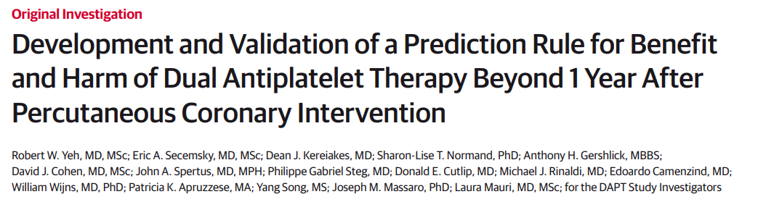
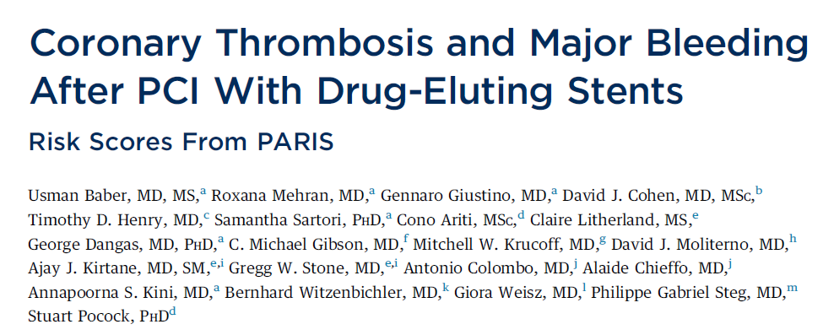
The era of risk scores
27 bleeding risk scores identified with at least one publication!!
Baber U, et al. J Am Coll Cardiol. 2016 May 17;67(19):2224-2234.
Yeh et al. JAMA. 2016 Apr 26;315(16):1735-49.
Costa F, et al. Lancet. 2017 Mar 11;389(10073):1025-1034

Slide 34
Long Term Scores in PCI patients: Characteristics
 | BleeMACS | DAPT | PARIS | PRECISE-DAPT
Year of publication | 2018 | 2016 | 2016 | 2017
Patients, n | 15401 | 11648 | 4190 | 14963
Patient population | ACS undergoing PCI | Stable event-free 12 months after PCI | stableand unstable undergoing PCI | Stable and unstable undergoing PCI
Bleeding outcome | Serious spontaneous bleeding at 1 year | Major bleeding between 12 and 30 months after PCI | Major bleeding over 2 years | Major or minor bleeding out-of-hospital (≥7 days after PCI), median follow-up 552 days
Bleeding def | Protocol definition | GUSTO definition | BARC definition | TIMI definition
External validation (c-statistic) | AUC=0.65 ACS_PCI and 0.63 ACS | AUC: 0.64 (bleeding) AUC:0.64 (ischemia) | AUC: 0.64 (bleeding) | AUC: 0.66 and 0.70

Slide 35
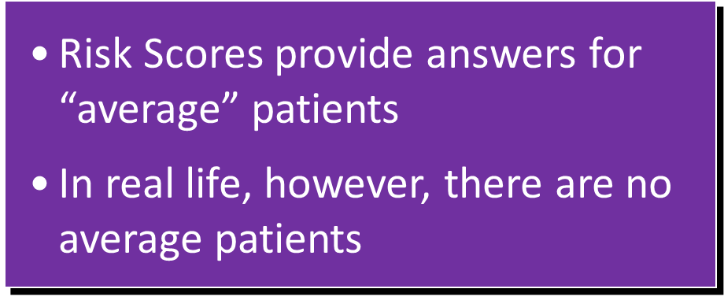
Risk Stratification Approach
Low Risk Outcome
Intermediate Risk Outcome
High Risk Outcome
Outcomes from an RCT
Mean Treatment Effect

Slide 36
Why was the ARC-HBR Initiative conceptualized?

Slide 37
Unanswered Questions
What age limit should qualify for HBR?
For patients on oral anticoagulants, how long should DAPT be?
Should we use risk scores? If yes, which one?
(no dedicated HBR score, for example, DAPT score can be applied after one year of DAPT only….)
What is the optimal DAPT duration for HBR patients?

Slide 38
Striving for a universal HBR Definition – ARC
Methodology:
“The purpose of the ARC: to develop definitions and nomenclature and related processes, optimized for application in pivotal clinical trials”
Review bleeding rates
in trials of antiplatelet therapy after stent
HBR criteria
in ongoing trials
Assess bleeding risk scores
Score design and performance
Impact of comorbidities
On bleeding rates in different trials
Defined HBR criteria
Major and Minor

Slide 39
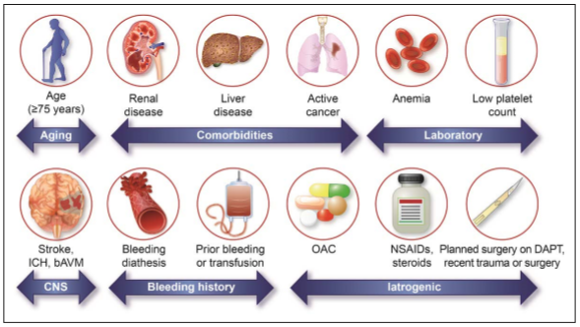
Presented at EuroPCR 2019 last week!
A consensus definition of patients at HBR was developed based on review of available evidence
Represents the first pragmatic approach to a consistent HBR definition in clinical trials evaluating the safety and effectiveness of devices and drug regimens for patients undergoing PCI
Patients are considered to be at HBR if at least 1 major and 2 minor criteria are met

Slide 40
Major HBR criteria
Anticipated long-term oral anticoagulation
Severe/End-stage CKD (eGFR <30ml/min)
Hb <11g/dl
Spontaneous bleeding requiring hospitalization or transfusion in the past 6 mo or any time, if recurrent
Moderate/severe baseline thrombocytopenia (<100x10⁹/L)
Chronic bleeding diathesis
Liver cirrhosis with portal hypertension
Active malignancy (excluding nonmelanoma skin cancer) within the past 12 months)
Previous spontaneous ICH (at any time)/ traumatic ICH (within the past 12 months)/ presence of a bAVM/ moderate or severe ischemic stroke within the past 6 mo
Nondeferrable major surgery on DAPT
Recent major surgery or major trauma within 30 d before PCI
Minor HBR criteria
Age ≥75 y
Moderate CKD (eGFR 30-59 ml/min)
Hb 11 – 12.9 g/dl for men and 11 – 11.9 g/dl for women
Spontaneous bleeding requiring hospitalization or transfusion within the past 12 mo not meeting the major criterion
Long-term use of oral NSAIDs or steroids
Any ischemic stroke at any time not meeting the major criterion
According to ARC HBR definition -patients are considered to be at HBR if at least 1 major and 2 minor criteria are met
Circulation. 2019;139:00–00. DOI: 10.1161/CIRCULATIONAHA.119.040167

Slide 41
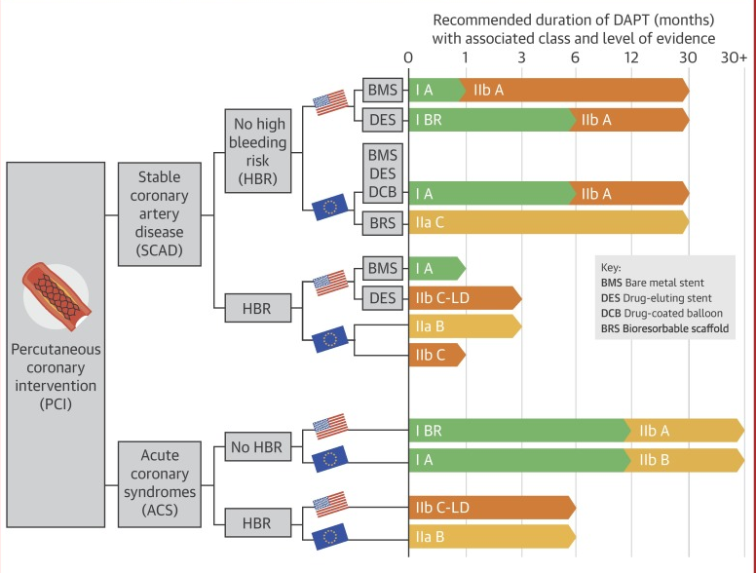
Current Guidelines: DAPT for HBR Patients Undergoing PCI with DES
Stable CAD
No HBR | 6 months or longer*
HBR | 1 to 3 months
ACS
No HBR | 12 months or longer*
HBR | 6 months
*Consider longer duration based on PCI complexity, DAPT score ≥2 or risk profile
Capodanno D, Angiolillo DJ, et al. J Am Coll Cardiol.2018;72:2915-2931

Slide 42
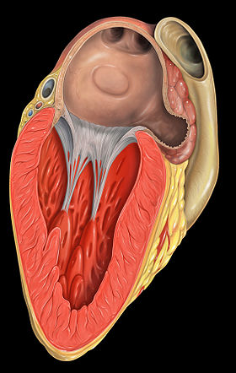
Left Atrial Appendage (LAA)
Among patients with NVAF, the vast majority of thrombus material is located within or involves the LAA
Reasons:
The intense fibrosis and inflammation seen in the LA of patients with AF are particularly intense in the LAA
The fibrillating LAA is the only area within the left atrium that is comprised of pectinate muscle and can create an appropriate milieu for blood stasis and thrombus formation

Slide 43
LAA Closure
The importance of the LAA in thromboembolic risk among patients with AF provides the rationale for closure of the LAA in patients who are candidates for but have either absolute or relative contraindications to long-term oral anticoagulation.
WATCHMAN LAA Closure Device

Slide 44
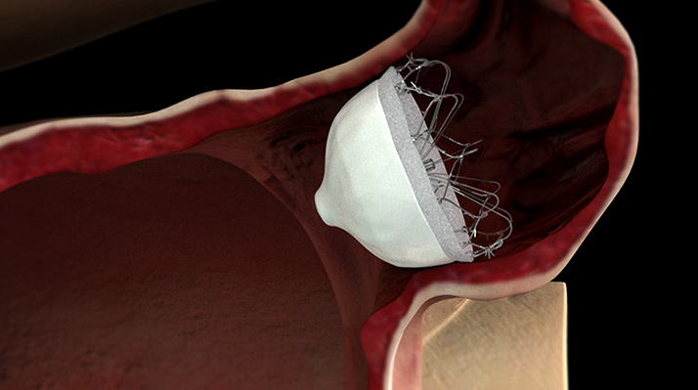
Which Patients with AF are candidates for LAA Closure?
Thrombocytopenia or known coagulation defect associated with bleeding
Recurrent bleeding, including gastrointestinal, genitourinary, respiratory
Prior severe bleeding, including intracranial hemorrhage
Combined use of dual antiplatelet and anticoagulant therapy
Poor compliance or intolerance with anticoagulant therapy
High risk of the patient falling or prior falls resulting in injury
Temporary LAA occlusion may be done for:
Valve replacement or repair
CABG surgery

Slide 45
Management after Device Implantation
Warfarin plus Aspirin for about six weeks after implantation
Followed by Clopidogrel plus Aspirin out to six months
Aspirin continued for life
For patients with absolute contraindications to oral anticoagulants, DAPT given immediately after implantation for six months
All patients referred for a post-procedural TEE at about six weeks

Slide 46
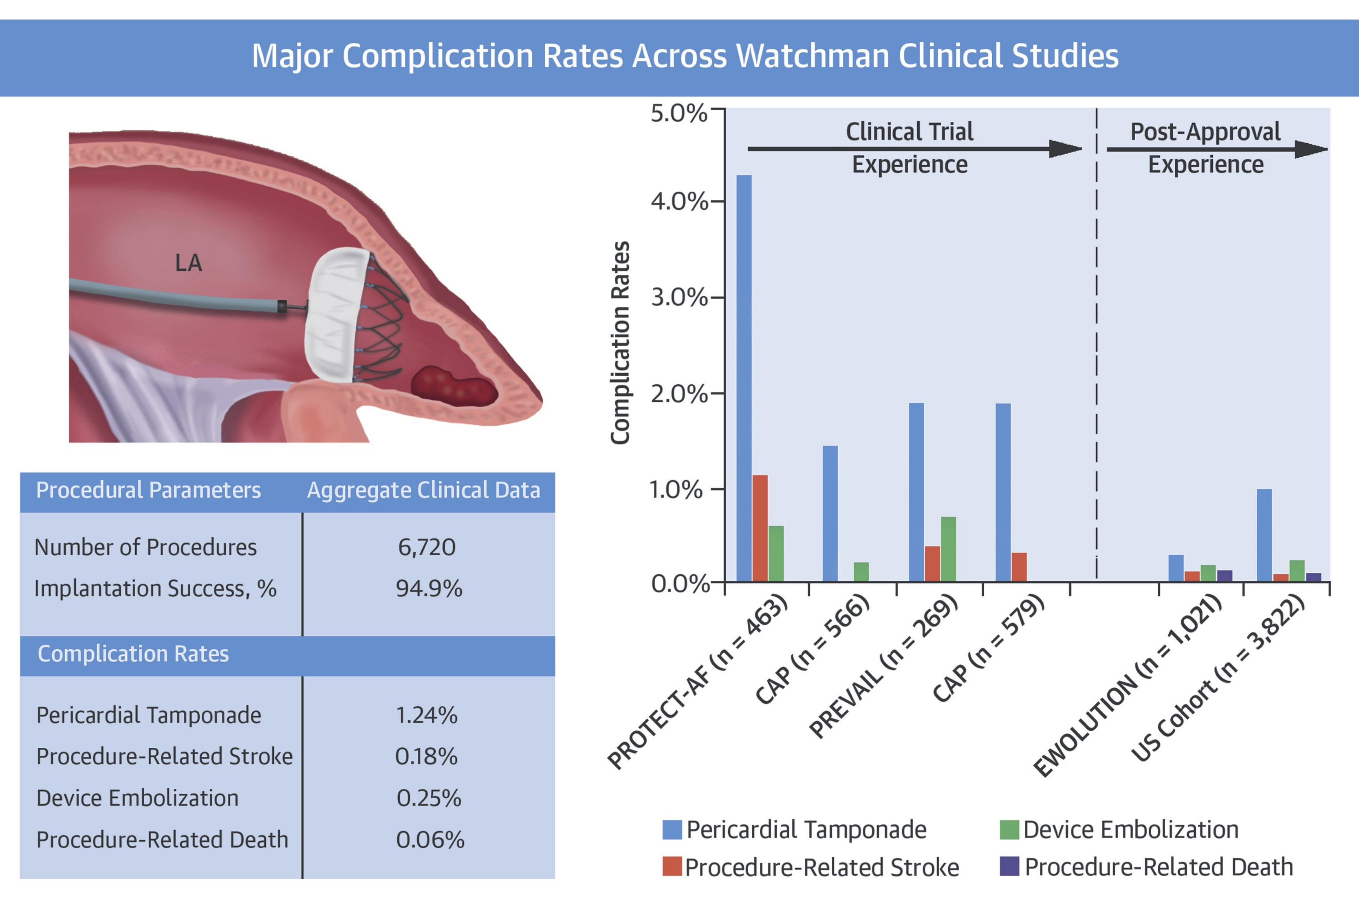
Post-Approval U.S. Experience with LAAC device
In March 2015, U.S. FDA approved LAAC device to reduce the risk of stroke in patients with NVAF based primarily on 2 pivotal RCTs: PROTECT-AF and PREVAIL
LAAC procedures to date performed by either Interventional Cardiologists or EPs
Education plan formulated by FDA and manufacturers recommend:
Knowledge base of stroke prevention in NVAF
Information about therapeutic alternatives
Previous transseptal puncture experience
Implantation case review
Simulator training
Attendance at physician training event
Reddy, V. Y. et al. J Am Coll Cardiol. 2017;69(3):253-61

Slide 47
Conclusions
High bleeding risk population represents a significant proportion of coronary artery disease (CAD) patients undergoing coronary stent implantation.
Recent and ongoing trials are focusing on this vulnerable patient population however, several unanswered questions remain.
The ARC-HBR Initiative was conceptualized to address many of these questions as well as proposing a universal definition of high bleeding risk.

Slide 48
Thank you!!!

Slide 49
THANK YOU!

